Slide 1
Iot Based Phototherapy Machine
NITHIN KRISHNAN P
TVE18MCA039
S6 MCA
ROLL NO : 37

Slide 2
Introduction
Phototherapy machine is used for curing the jaundice condition on newborn babies which arises due to high level of yellowish colour on skin.
Project introduces a machine that will automatically detect and cure the condition automatically.
Multiple sensors are also included with the machine and Readings from the sensors can be monitored via Computer or Mobile.

Slide 3
Existing System
In the Existing system the nurse or doctor need to monitor the baby manually at Regular intervals.
There may be large number of babies in a hospital so, monitoring each of them is not easy.
Much higher cost for hardware components.

Slide 4
Proposed System
The intensity of light is reduced automatically.
The phototherapy machine is controlled automatically
Doctor can monitor the machine
Weight sensor, Temperature, Heart beat sensors are included.
Less cost compared to existing machine.

Slide 5
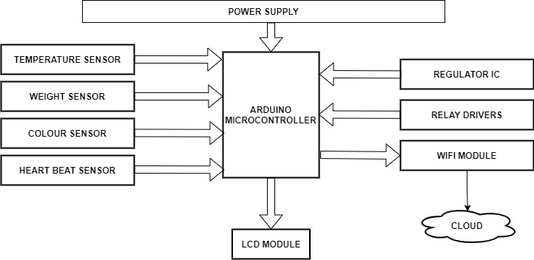
Block Diagram

Slide 6
Components Used
Esp32 Microcontroller
Regulator IC
LCD Module
Load/Weight Sensor
Temperature Sensor
Pulse Sensor
Colour Sensor

Slide 7
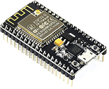
Mod 1:ESP32 Microcontroller
Inbult wifi,bluetooth
Speed 160-240 MHz
3.3v power supply

Slide 8
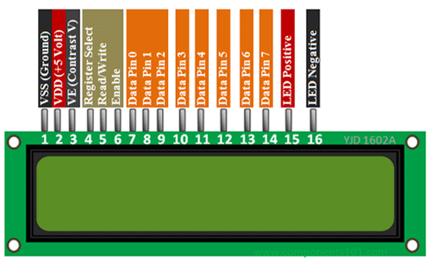
Mod 2: LCD Module
16x2
Interface IC HD44780
4.7V to 5.3V

Slide 9
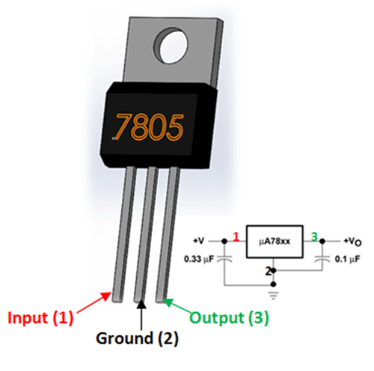
Mod 3:Regulator IC
7805 Ic
5V Positive Voltage Regulator
Short circuit protection

Slide 10
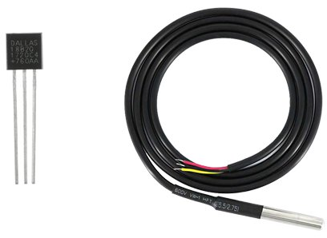
Mod 4:Temperature Sensor
1 digital pin
-55°C to +125°C
3V to 5.5V power supply

Slide 11
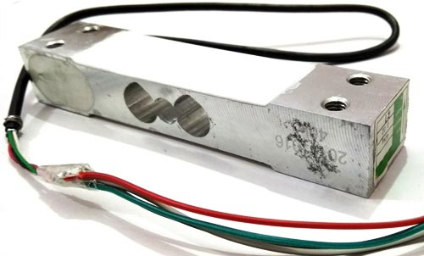
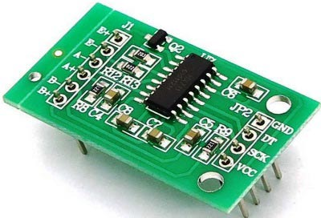
Mod 5:Weight sensor
Force to Digital
Upto 10kg
Hx711 (24bit adc)

Slide 12
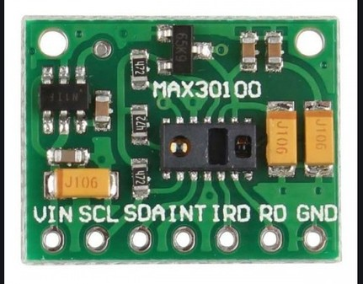
Mod 6:Pulse Sensor
MAX30100
it reads both light
sources and stored them in a buffer that
can be read via I2C.

Slide 13
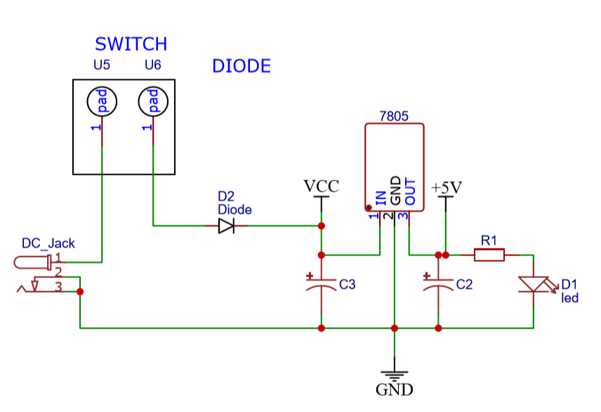
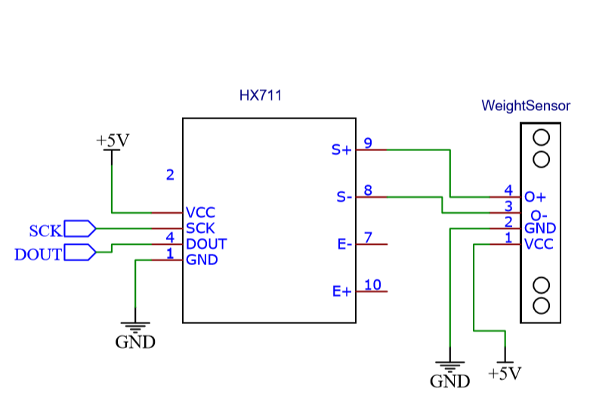
Circuit Diagram

Slide 14
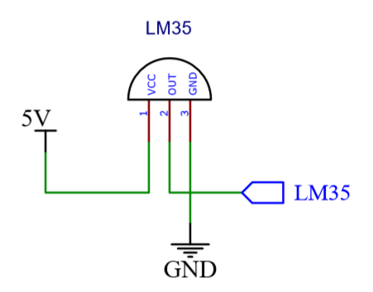
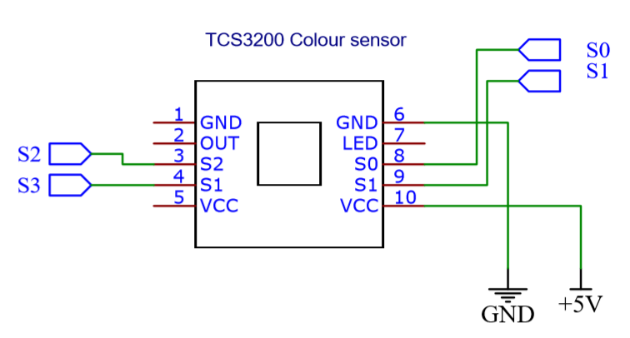
Circuit Diagram

Slide 15
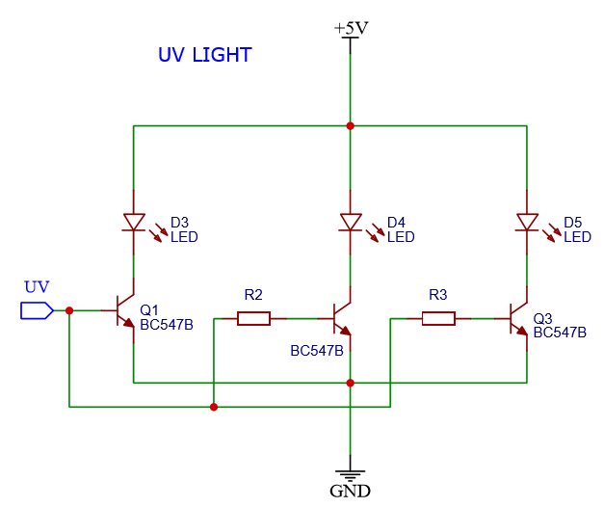
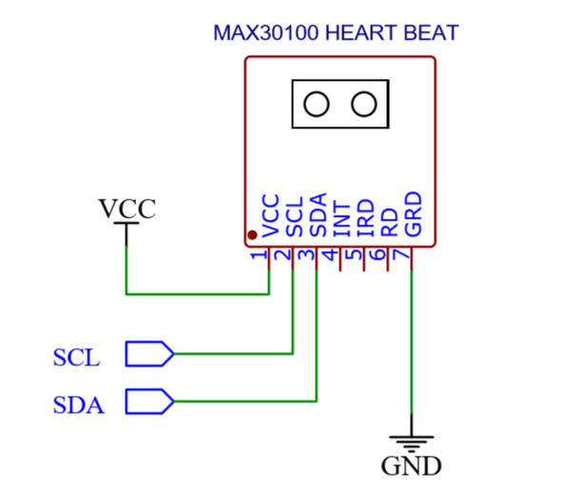
Circuit Diagram

Slide 16
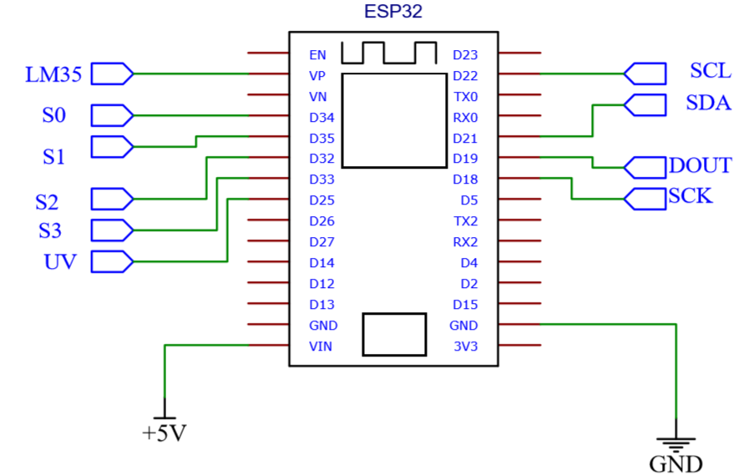
Circuit Diagram

Slide 17
Experimental Evaluation
Hardware Requirements
ESP32 Microcontroller
Temperature Sensor
Weight Sensor
7805 IC
Pulse Oximeter
Colour Sensor

Slide 18
Experimental Evaluation
Software Requirements
Windows 10
Arduino IDE
XAMPP

Slide 19
Methodology
ESP32 Micro controller is used to control all the sensor
Temperature sensor is used to sense the temperature
Weight Sensor finds the weight of the Baby
Pulse Oximeter detects the Heartbeat and spo2 values

Slide 20
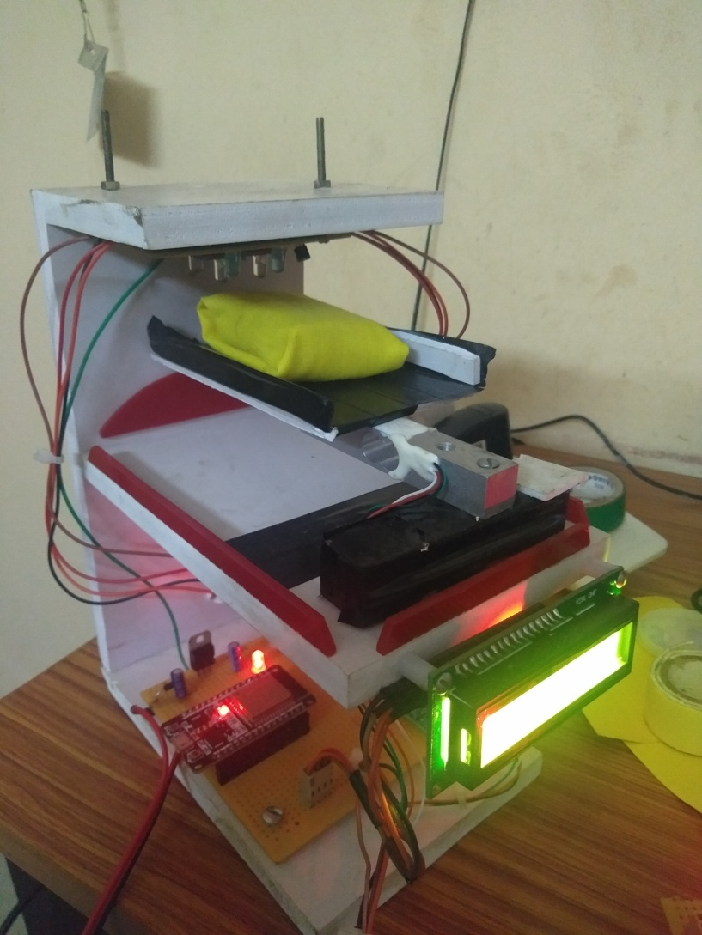
Assembled model

Slide 21
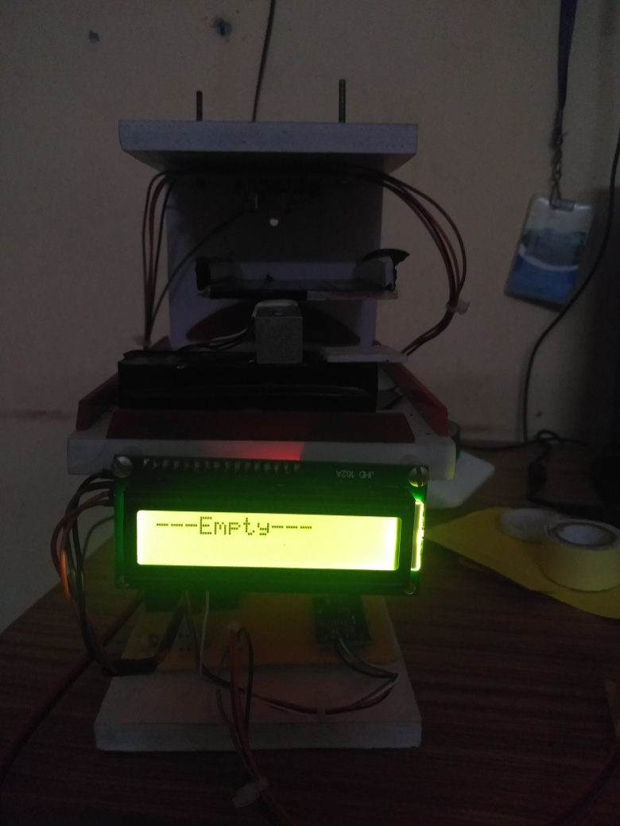
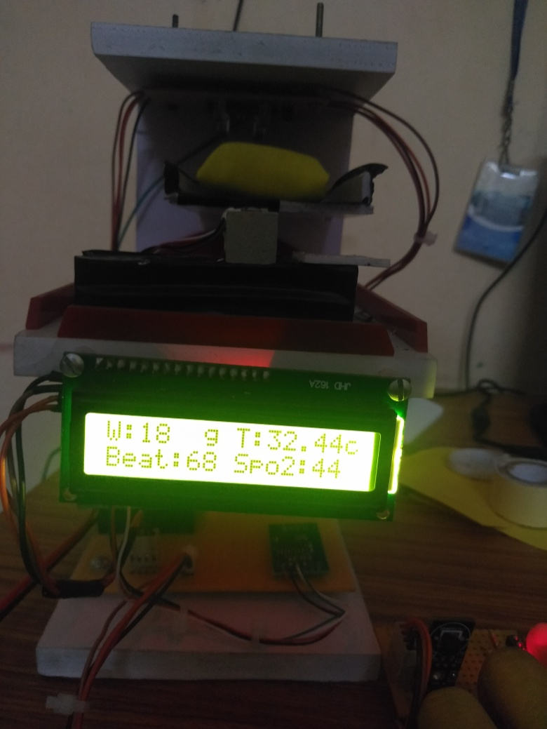
Final Results

Slide 22
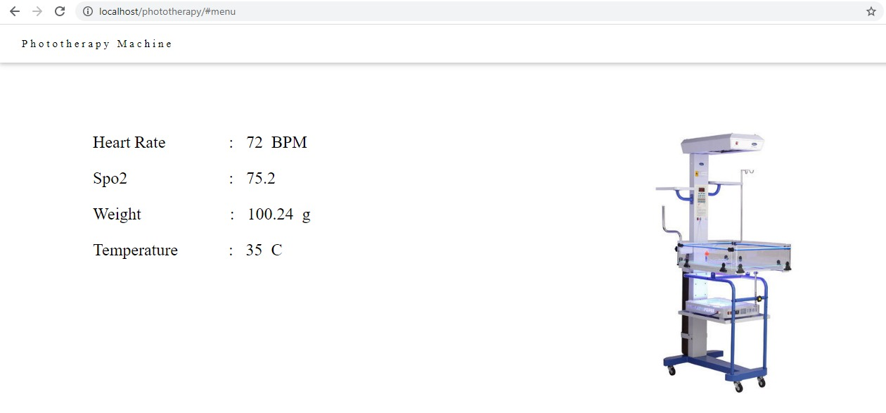
Website

Slide 23
Literature Review
M. Afnan Nabizath, S.Anshu Soumya, V. Boomitha, C. Meena and P. Sridharan Proposed a paper called “New Design for Phototherapy Device and Skin Colour Analysis” to detect and cure jaundice in new born babies using Light therapy.
Ankan Gupta, Ashok Kumar, and PreetiKhera Proposed a paper on “Jaundice Prediction through NonInvasive Techniques: Issues and Challenges” it talks about the problems rise in using the high intensity light on baby.

Slide 24
Results and Discussion
System Performes all Functionalities as Expected.
This proposed System have met all the Proposed Requirements
Expected Light Sensor and all Other sensors are working.

Slide 25
Future Scope
Making a cheap phototherapy machine that can be used to
Cure more than one baby at the same time.
The doctor can have the device that can be used to control
all the sensors
A mobile application can be introduced
More advanced and precise Sensors can be included

Slide 26
Conclusion
Here the Proposed system is an Phototherapy machine using IoT devices. It was brought about a new prototype which overcomes the drawbacks of the existing devices.
The System works faster than other devices and will produce more accurate results. The implementation of this design is purely driven by usage os Weight sensor, Temperature sensor, Colour sensor and Pulse Oximeter
All the datas from the servers are instantly uploaded onto the server which can be monitored via a Android device or Computer. Overall the result achieved are satisfying and accurate.And we can conclude that the project was successful.

Slide 27
Thank You…

